Slide 1

Navigation
Trainer markova.milica@gmail.com
Assistant ristopavlov@gmail.com

Slide 2
Module Contents
ASP.NET MVC
Routing
Routing by naming Convention
Default Route
Default ActionMethod
Decorating ActionMethod
Controller Base Route
Route Parameters Using Route Attribute
Code academy @ Skopje, 2018-2019

Slide 3
Routing
ASP.NET MVC
Is a way to call different action depending on the request information
Can be done using Naming Convention
Can be done by decorating ActionMethod with "Route" attribute
Code academy @ Skopje, 2018-2019

Slide 4
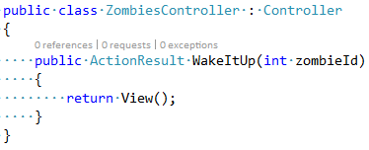
Routing By Naming Convention
ASP.NET MVC
Which ActionMethod will be executed is depends on the name of the Controller and the name of the ActionMethod
Example /Zombies/WakeItUp/420
Code academy @ Skopje, 2018-2019

Slide 5
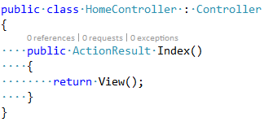
Default Route
ASP.NET MVC
The default route is /Home/Index/{id}(optional)
In order to work you need to have a Controller called HomeController and in it you must have ActionMethod called Index
Code academy @ Skopje, 2018-2019

Slide 6
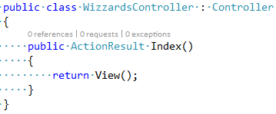
Default ActionMethod
ASP.NET MVC
We can also include only the controller name in the route and the default ActionMethod will be called /Wizzards
Code academy @ Skopje, 2018-2019

Slide 7
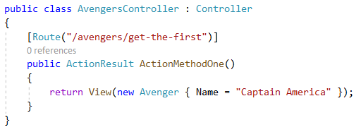
Decorating Action Method
ASP.NET MVC
Code academy @ Skopje, 2018-2019

Slide 8
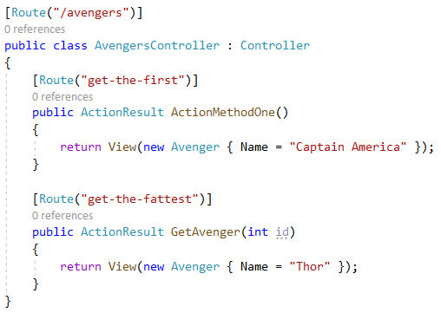
Controller Base Route
ASP.NET MVC
Code academy @ Skopje, 2018-2019

Slide 9
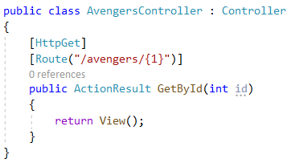
Route Parameters using Route Attribute
ASP.NET MVC
Code academy @ Skopje, 2018-2019

Slide 10
?
ASP.NET MVC
Code academy @ Skopje, 2018-2019

